Slide 1


What’s in it for me?
Reasons to be active in your state and region

Slide 2


September 26-30
Tampa, Florida

Slide 3



Follow Us
Notes:
Join us on all your social networks

Slide 4
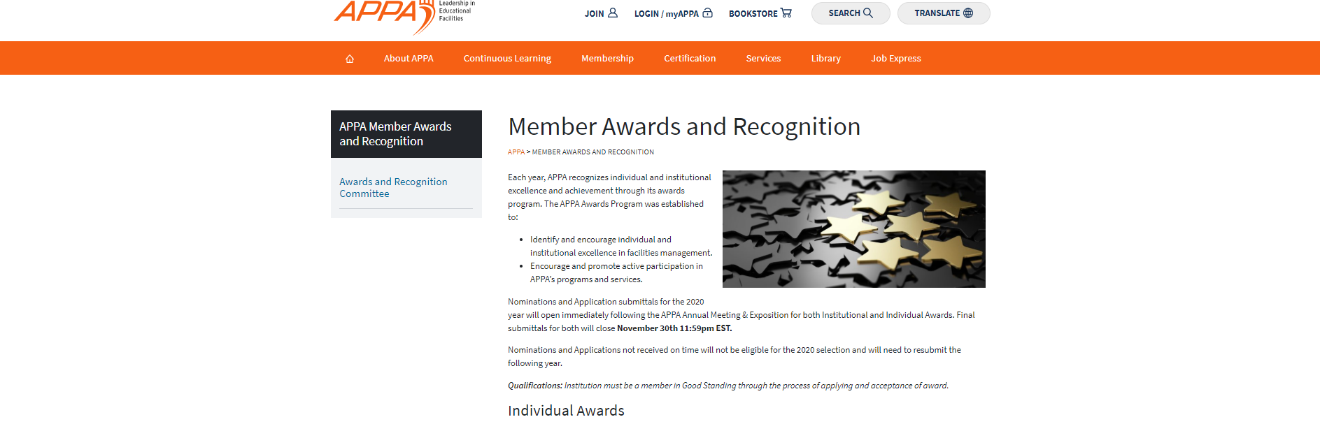
Apply for Awards & Recognition
Notes:
We want to know about your successes. Apply for all the awards if you can.

Slide 5

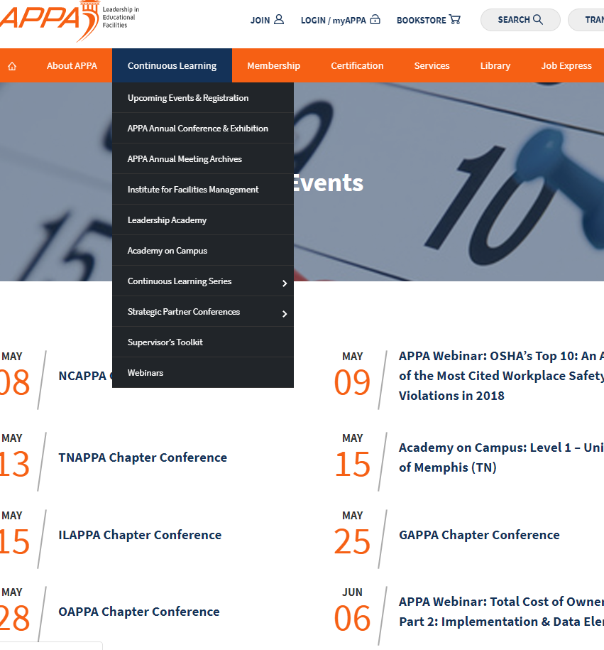
Education Opportunities
Leadership Academy
APPA University
Supervisor’s Toolkit
Continues Learning Series
Academy on Campus
Webinars
State, Regional, & National Conference
Notes:
Scholarships available – States were given $5,000. Also available through SRAPPA

Slide 6
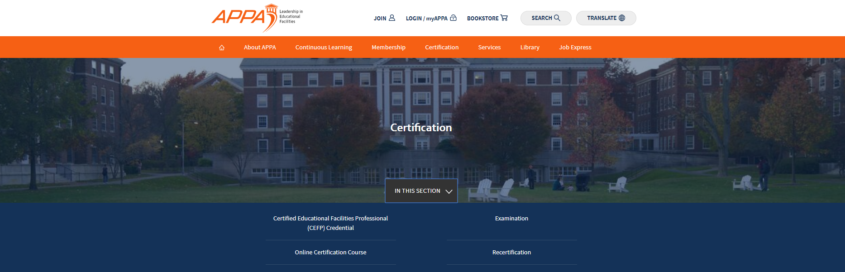

Credentialing Coupons
Notes:
We have bought down the price of the exam.
SRAPPA Members can now take the EFP exam for $450 (an $1100 value) and the CEFP for $550 (a $1300 value).
This offer is available only to institutional members of both APPA and SRAPPA.
The SRAPPA Board has voted to approve an even greater discount by offering a refund of $150 for those taking and passing the CEFP exam.

Slide 7


Networking Opportunities
Conference
Education Programs
Mentors
Drive-in Workshops
Special Groups
  K-12
  HBCU
  Community Colleges
  Young Professionals

Slide 8

Other Resources
Facilities Management Evaluation Program
Standards and Codes
Facilities Performance Indicators (FPI)
Body of Knowledge (BOK)
Facilities Manager Magazine (now online)
Thought Leadership Series

Slide 9
SCAPPA Scholarships
SRAPPA Scholarships – to be awarded to the first qualified recipients from the SCAPPA attending Supervisor’s Toolkit, Leadership Academy, or APPA University before May of 2021. These funds may only be used to cover the registration of the event. Initial funded amount $5,000. Balance as of February 2020 is $515. May be combined with other scholarships.
SCAPPA Members Scholarships - to be awarded to the qualified recipients from SCAPPA attending Supervisor’s Toolkit, Leadership Academy, or APPA University. These funds are to be awarded after the SRAPPA Scholarship is used or after June 2021 whichever comes first. These funds may only be used to cover the registration of the event. Initial funded amount $10,000.
Supervisor’s Toolkit Training Scholarship – these funds are to be used to reduce the cost of the Supervisor’s toolkit training for qualified SCAPPA Members to when the toolkit Is held in SC. These funds may only be used to cover 50% of the standard fee and may not be used for travel, hotels, or food. These funds may be used by the host school to expand the number of attendees from their own institution. No institution may receive more than $1,250 over a three-year timeframe from this fund. Initial funded amount $10,000.
Financial assistance for post-secondary education to children of qualifying SCAPPA members. Rising college freshmen that are children of SCAPPA members employed full-time in the field of facilities management for at least 12 months are eligible. Amount of funds available vary from year to year.

